Slide 1
Semantiskais tīmeklis
–––––––––––––––––
Semantic Web
Andrejs Lesovskis
Notes:
©2005 Microsoft Corporation. All rights reserved.
This presentation is for informational purposes only. Microsoft makes no warranties, express or implied, in this summary.

Slide 2
Lekcijas plāns
Ievads Resource Description Framework
RDF trijnieki
RDF Schema
RDF un relāciju datu bāzes

Slide 3
W3C Semantic Web Activity Statement
"Resource Description Framework ir valoda, kura tika izstrādāta, lai atbalstītu Semantisko tīmekli tāpat kā HTML palīdzēja iniciēt globālo tīmekli (WWW). RDF ir ietvars, kas atbalsta resursu aprakstīšanu un meta datu (datu par datiem) izmantošanu tīmeklī. RDF nodrošina vispārējās struktūras, kuras var izmantot savienojamību XML datu apmaiņai.“
W3C

Slide 4
Resource Description Framework (RDF)
Resurss ir jebkas, ko var identificēt un aprakstīt.
Resurss tiek identificēts ar URI vai kā tukšs mezgls (blank node).
Resurss var būt abstrakts.
Pirmo precīzu resursa definīciju var atrast RFC 2396 standartā:
    http://tools.ietf.org/html/rfc2396

Slide 5
RDF izmantošanas mērķi
Datu integrēšana no vairākiem avotiem.
Datu atkārtota izmantošana citos projektos vai organizācijās.
Datu decentralizēšana.

Slide 6
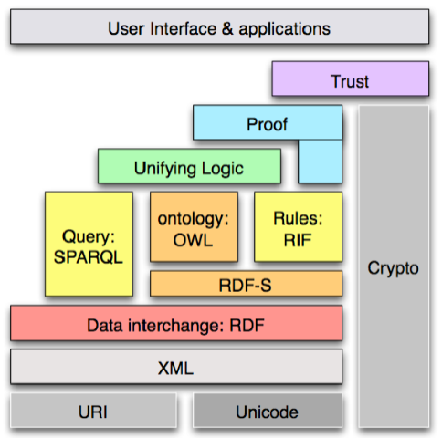
Semantiskā tīmekļa slāni

Slide 7
Resource Description Framework (RDF)
1
Aprakstāmā resursa RDF identifikators
2
Norāde uz RDF vārdtelpu
<?xml version="1.0"?>
<River rdf:ID="Yangtze"
xmlns:rdf="http://www.w3.org/1999/02/22-rdf-syntax-ns#"
xmlns="http://www.geodesy.org/river#">
<length>6300 kilometers</length>
<startingLocation>western China's Qinghai-Tibet Plateau</startingLocation>
<endingLocation>East China Sea</endingLocation>
</River>
Notes:
©2005 Microsoft Corporation. All rights reserved.
This presentation is for informational purposes only. Microsoft makes no warranties, express or implied, in this summary.

Slide 8

RDF triple (1)
Katrs RDF trijnieks (triple) satur sekojošos trīs elementus
Subjekts (subject/resource)
Predikāts/īpašība (predicate/property)
Objekts (object/value)
resource
property
value
Notes:
©2005 Microsoft Corporation. All rights reserved.
This presentation is for informational purposes only. Microsoft makes no warranties, express or implied, in this summary.

Slide 9

RDF triple (2)
Piemērs:
"The owner of the site http://www.gmail.com is Google“
Owner
http://ww.gmail.com
Notes:
©2005 Microsoft Corporation. All rights reserved.
This presentation is for informational purposes only. Microsoft makes no warranties, express or implied, in this summary.

Slide 10
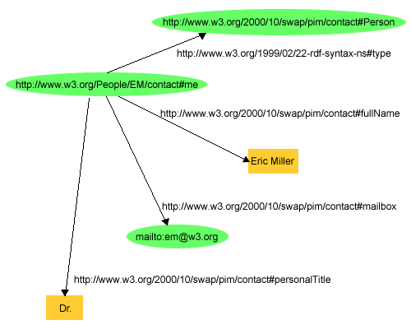
RDF triple piemērs (1)
RDF grafa piemērs:

Slide 11
RDF triple piemērs (2)
RDF/XML kods, kas atbilst grafam no iepriekšējā slaida:
<?xml version="1.0"?>
<rdf:RDF
xmlns:rdf="http://www.w3.org/1999/02/22-rdf-syntax-ns#"
xmlns:contact="http://www.w3.org/2000/10/swap/pim/contact#">
<contact:Person rdf:about="http://www.w3.org/People/EM/contact#me">
<contact:fullName>Eric Miller</contact:fullName>
<contact:mailbox rdf:resource="mailto:em@w3.org"/>
<contact:personalTitle>Dr.</contact:personalTitle>
</contact:Person>
</rdf:RDF>

Slide 12
RDF/XML piemērs
<rdf:RDF xmlns:rdf="http://www.w3.org/1999/02/22-rdf-syntax-ns#"
xmlns:dc="http://purl.org/dc/elements/1.1/"
xmlns:geo="http://www. w3.org/2003/01/geo/wgs84_pos#"
xmlns:edu="http://www.example.org/">
<rdf:Description rdf:about="http://www.princeton.edu">
<geo:lat>40.35</geo:lat>
<geo:long>-74.66</geo:long>
<edu:hasDept rdf:resource="http://www.cs.princeton.edu"/>
</rdf:Description>
<rdf:Description rdf:about="http://www.cs.princeton.edu">
<dc:title>Department of Computer Science</dc:title>
</rdf:Description>
</rdf:RDF>

Slide 13
RDF konteineru tipi
Literāļus vai resursus var grupēt konteineros, kuri var būt sekojošie:
Bag – rdf:bag elements.
Sequence – rdf:seq elements.
Alternate – rdf:alt elements.
Notes:
©2005 Microsoft Corporation. All rights reserved.
This presentation is for informational purposes only. Microsoft makes no warranties, express or implied, in this summary.

Slide 14
RDF Schema (RDFS)
RDF Schema izmanto, lai deklarētu vārdnīcas, kas satur specifisku klašu un īpašību aprakstus.
RDF Schema var uzskatīt par objektorientētu valodu tipu sistēmu analogu.
W3C pieņēma RDF Vocabulary Description Language 1.0: RDF Schema rekomendācijas 2004. g. sākumā.
Notes:
©2005 Microsoft Corporation. All rights reserved.
This presentation is for informational purposes only. Microsoft makes no warranties, express or implied, in this summary.

Slide 15
RDF Schema klases
rdfs:Resource,
rdfs:Class,
rdfs:Literal,
rdfs:Datatype,
rdf:XMLLiteral,
rdf:Property.
Notes:
©2005 Microsoft Corporation. All rights reserved.
This presentation is for informational purposes only. Microsoft makes no warranties, express or implied, in this summary.

Slide 16
RDF Schema īpašības
rdfs:range,
rdfs:domain,
rdfs:type,
rdfs:subClassOf,
rdf:subPropertyOf,
rdf:label,
rdfs:comment.
Notes:
©2005 Microsoft Corporation. All rights reserved.
This presentation is for informational purposes only. Microsoft makes no warranties, express or implied, in this summary.

Slide 17
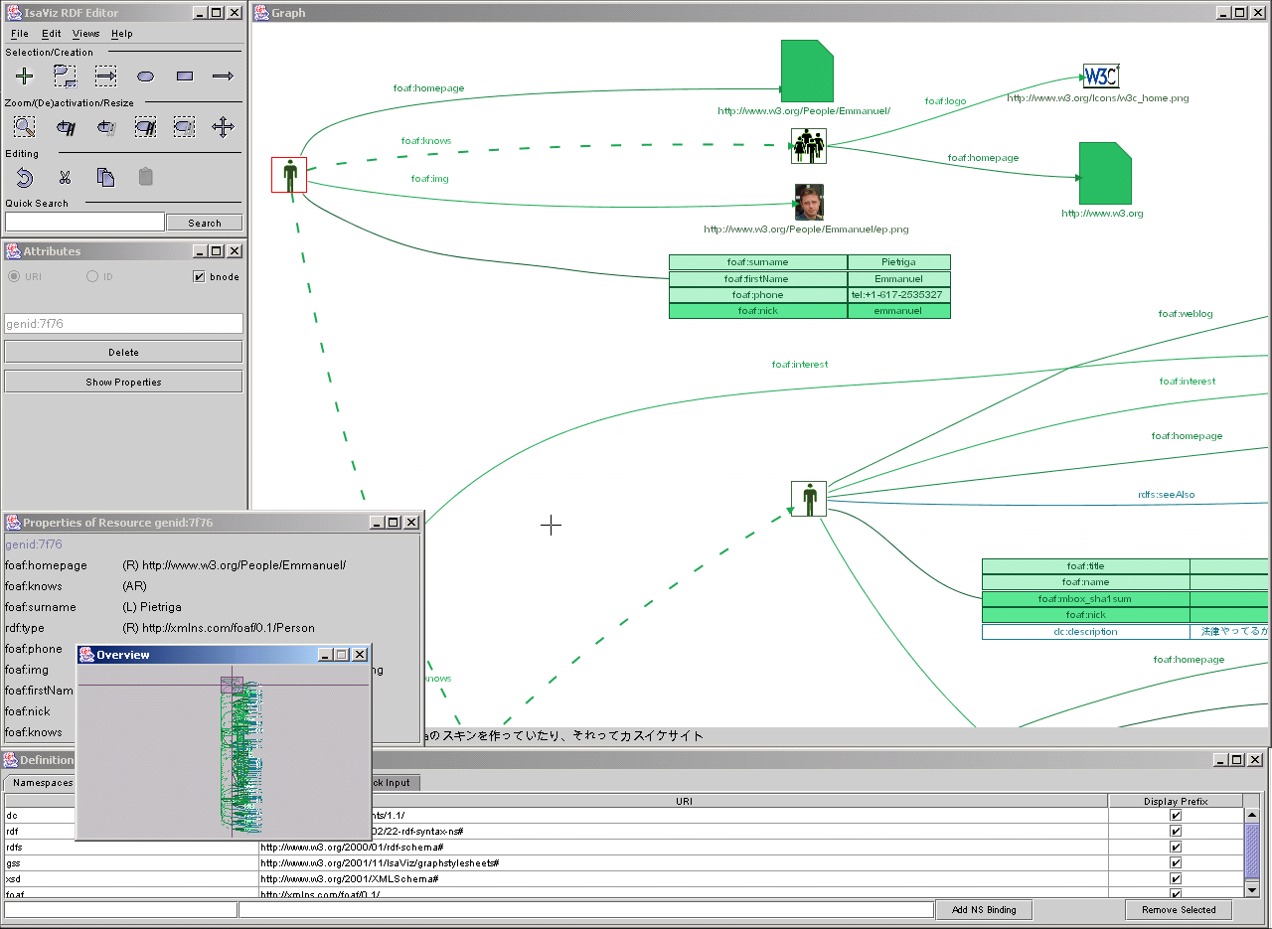
Rīki: IsaViz
Notes:
©2005 Microsoft Corporation. All rights reserved.
This presentation is for informational purposes only. Microsoft makes no warranties, express or implied, in this summary.

Slide 18
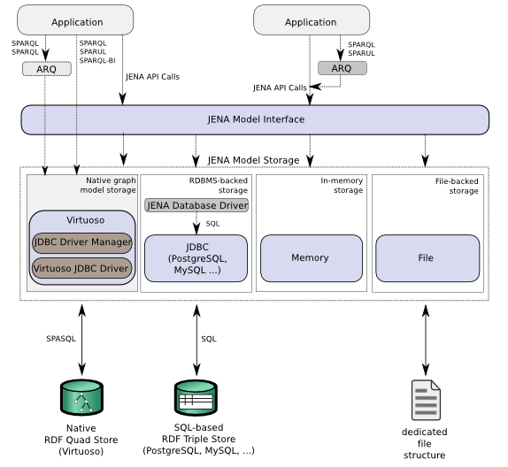
Rīki: Jena
Notes:
©2005 Microsoft Corporation. All rights reserved.
This presentation is for informational purposes only. Microsoft makes no warranties, express or implied, in this summary.

Slide 19
RDF un relāciju datu bāzes
Kādēļ var izmantot RDBMS:
Ļoti ātra semantisko datu izmēra palielināšana.
RDBMS atbalsta transakcijas, atjaunošanu, replicēšanu un drošību.
RDBMS ir efektīva vaicājumu apstrāde.
Pieejamie risinājumi:
Oracle 11g RDF/OWL,
OpenLink Virtuoso.
Notes:
©2005 Microsoft Corporation. All rights reserved.
This presentation is for informational purposes only. Microsoft makes no warranties, express or implied, in this summary.

Slide 20
Paldies par uzmanību!
Notes:
©2005 Microsoft Corporation. All rights reserved.
This presentation is for informational purposes only. Microsoft makes no warranties, express or implied, in this summary.

